Slide 1
SharePoint Online Page Load Performance
Speaker Name

Slide 3
Objectives
After completing this section, you will:
Understand common causes of SharePoint Online page load performance issues
Understand best practice guidence and recommendations for achieving optimal SharePoint Online page performance
Understand how to avoid being throttled

Slide 4
Common causes of slow page load performance

Slide 5
Custom requests to SharePoint
JavaScript code making too many JSON and REST API calls to SharePoint Online
Each call requires at least one round-trip from SharePoint Online servers to/from SQL backend servers
Performance of these calls can vary as it depends on many factors such as complexity of the query, the number of sites a user follows or likes, and the current load on SharePoint Online.
The amount of data returned in these calls can potentially have an impact on network bandwidth
Notes:
For more information on JavaScript threading, please see https://www.red-gate.com/simple-talk/dotnet/asp-net/javascript-single-threaded and https://www.sohamkamani.com/blog/2016/03/14/wrapping-your-head-around-async-programming.
JavaScript engines on web browsers are single-threaded in nature which means that all these JavaScript calls will be executed on a single computing thread.

Slide 6
Recommendations – Custom requests
Recommended guidance for custom external calls to SharePoint
Limit the number of custom JSOM and Rest API calls to SharePoint
The SPO product group recommends 6 or fewer (per page load)
Modern site pages should contain no more than 25 calls
Avoid having numerous controls requesting exactly the same data numerous times on a page
Do not embed redundant custom JavaScript and CSS throughout the page body
Batching JavaScript calls will help reduce number of roundtrips to SharePoint server and can increase performance.
SharePoint PnP (an open-source initiative led by Microsoft) has published a JavaScript SharePoint library with batching capability that can be used to batch JavaScript calls together. https://github.com/SharePoint/PnP-JS-Core/wiki/Batching
Notes:
Remediate performance issues related to too many calls on a page
If a page contains too many calls, you can use the list of URLs in the Requests to SharePoint results to determine whether there are any repeated calls, calls that should be batched, or calls that return data that should be cached.
Batching REST calls can help to reduce performance overhead. For more information about API call batching, see Make batch requests with the REST APIs.
Using a cache to store the results of an API call can improve the performance of a warm request by allowing the client to use the cached data instead of making an additional call for each subsequent page load. There are multiple ways to approach this solution depending on the business requirement. Typically if the data will be the same for all users, using a middle-tier caching service like Azure Redis cache is a great option to significantly reduce API traffic against a site, as the users would request the data from the caching service instead of directly from SPO. The only SPO calls needed would be to refresh the middle-tier's cache. If the data will fluctuate on an individual user basis, it may be best to implement a client-side cache, like LocalStorage or even a Cookie. This will still reduce call volumes by eliminating subsequent requests made by the same user for the cache duration but will be less efficient than a dedicated caching service. PnP allows you to use LocalStorage with little additional development required.
Before you make page revisions to remediate performance issues, make a note of the page load time in the analysis results. Run the tool again after your revision to see if the new result is within the baseline standard and check the new page load time to see if there was an improvement.

Slide 7
Images
Many large image files on page
Many large static files within a SharePoint page can have a significant impact on page performance
Ex: (3 images @5mb per image = 15mb) x 40,000 page loads per day (for typical portal) = just over 585GB over the network just for that page.
This also means at least 120,000 calls to SQL (40,000 x 3 images) which can be avoided if they are in CDN as SQL is not used to return the images for the CDNs.
JS and CSS files are common static files that can also be served from CDN
CDNs also use HTTP2 which allows images to be loaded much faster and reduces bottlenecks on the page.
Notes:
HTTP/2 attempts to solve many of the shortcomings and inflexibilities of HTTP/1.1. Its many benefits include: Multiplexing and concurrency:
Several requests can be sent in rapid succession on the same TCP connection, and responses can be received out of order - eliminating the need for multiple connections between the client and the server
Stream dependencies: the client can indicate to the server which of the resources are more important than the others
Header compression: HTTP header size is drastically reduced
Server push: The server can send resources the client has not yet requested

Slide 8
Recommendations - Images
Recommended guidance for image optimization
Do not embed several 10MB thumbnail images throughout the page body
Use SharePoint image renditions (a feature available in classic publishing sites)
Allows you to serve up different versions of images based on pre-defined image dimensions.
Using image compression and optimization to speed up page loading in SharePoint
There are various tools available to use for compression and optimization, including Photo Gallery and third-party tools.
Use Microsoft’s content delivery network (CDN) to host static image files
Notes:
The image rendition resizing works by taking the smallest dimension you define, either width or height, and then resizing the image so that the other dimension is automatically resized based on the locked aspect ratio
https://docs.microsoft.com/en-us/office365/enterprise/image-optimization-for-sharepoint-online
Also see Performance guidance for SharePoint Online portals
https://docs.microsoft.com/en-us/sharepoint/dev/solution-guidance/portal-performance

Slide 9
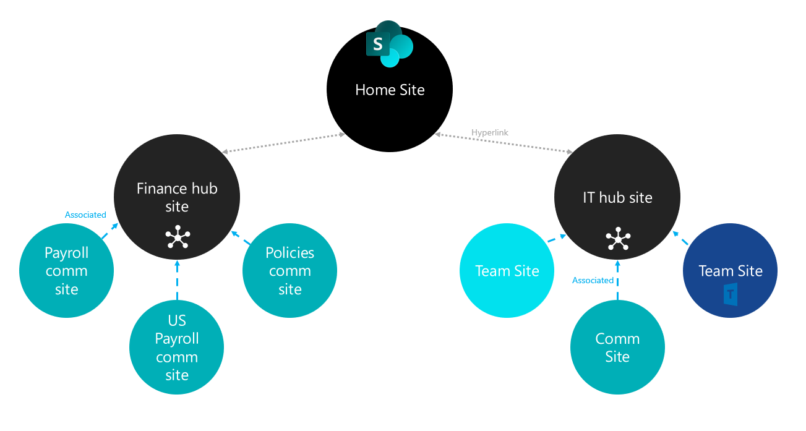
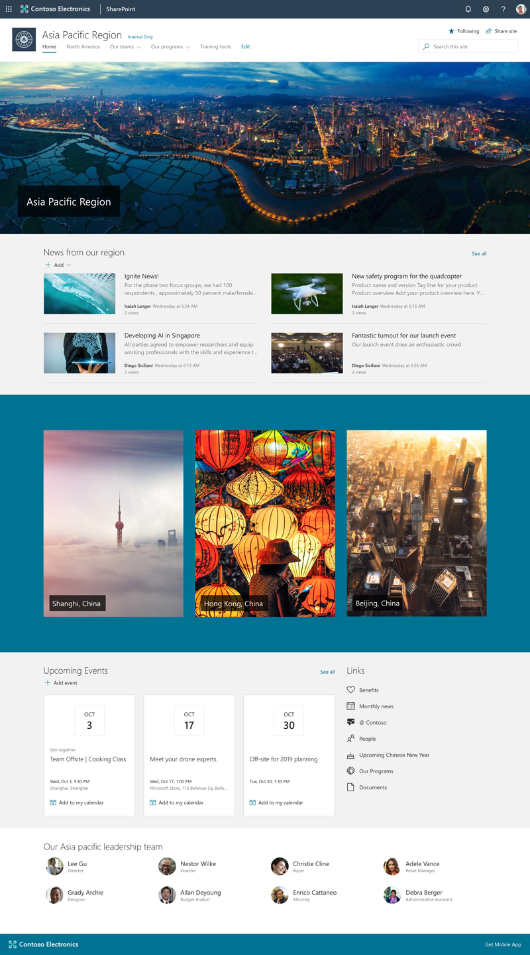
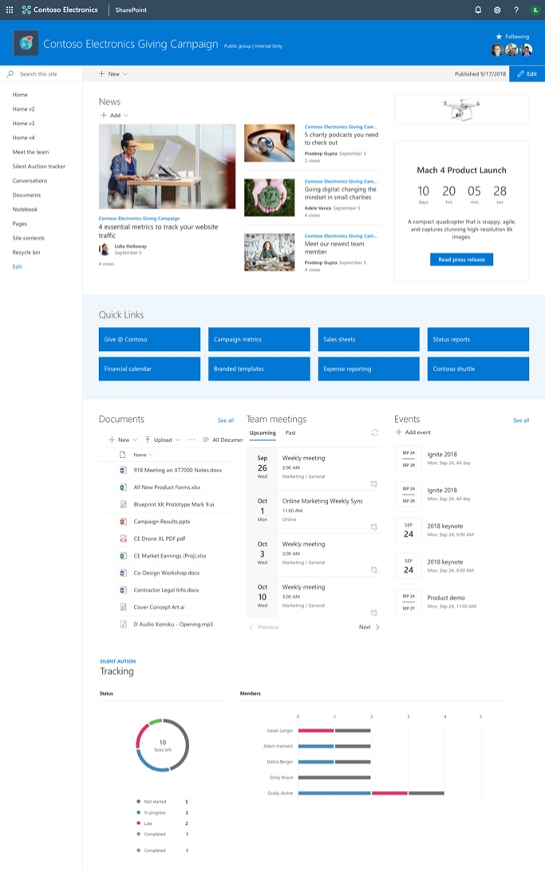
Recommendations - Site structure
Home, Hub sites, Team Sites and Communication sites
With Hub sites, you can re-associate sites, your intranet can respond and adapt to changes in your organization.
Create visually stunning and natively-mobile pages to share vision, news, information and resources.
Notes:
Avoid implementing deep hierarchies in a single site collection with unique permissions.
Use a flat site collection site structure that avoids using sub sites with a site collection.
Especially in company wide portal site collections

Slide 10
Recommendations - Site navigation
Site navigation recommendations:
Out-of-the-box managed navigation (MMS)
Allows you to use a Managed Metadata Service (MMS) Term set to configure the navigation nodes for a given site collection
Out-of-the-box search index (Search)
Allows you to query the SharePoint search index for sites and pages by constructing the proper search query.
Another advantage of this over managed navigation is that you benefit from security trimming.
Custom navigation provider
Needed when the out-of-the-box server-side navigation controls cannot be configured to meet one or more requirements of the proposed design.
Notes:
Using of out-of-the-box structural site navigation can easily become very resource-intensive (especially for complex site collection structures) and can result in significantly slower page-load performance.
Using a custom navigation solution that does not cache the navigation nodes it receives can lead to slow page-load performance.
For more details see
Navigation options for SharePoint Online
https://docs.microsoft.com/en-us/office365/enterprise/navigation-options-for-sharepoint-online?redirectSourcePath=%252fen-us%252farticle%252fNavigation-options-for-SharePoint-Online-adb92b80-b342-4ecb-99a1-da2a2b4782eb
Out-of-the-box managed navigation (MMS)
Allows you to use a Managed Metadata Service (MMS) Term set to configure the navigation nodes for a given site collection
Out-of-the-box navigation display controls automatically consume this data
The out-of-the-box navigation management page provides an easy-to-use user interface to manage the navigation nodes within an unconstrained hierarchy (unlimited depth).
Keep in mind that managed navigation is not security-trimmed, so your users might see links that they cannot access.
Out-of-the-box search index (Search)
Allows you to query the SharePoint search index for sites and pages by constructing the proper search query.
There's no specific out-of-the-box navigation management page and you must implement custom navigation display controls in custom masterpage to consume the data retrieved from the search queries.
The main advantage of this over managed navigation is that you benefit from security trimming.
Custom navigation provider
Needed when the out-of-the-box server-side navigation controls cannot be configured to meet one or more requirements of the proposed design.
The navigation store API provides a programmatic interface to manage the configuration of the navigation control consistently and securely. You can choose to have the custom navigation control use either a custom navigation store API or an out-of-the-box navigation store API.

Slide 11
Page Optimization Rules 101
Prefer modern SharePoint pages and sites
Modern SharePoint pages and sites are under continuous monitoring and investment for reliability, scalability, and performance.
Classic SharePoint Publishing sites have limited investment for reliability and scalability only.
Measure Page weight and requests
Resize images, compress scripts, and remove unnecessary dependencies.
Pages that require multiple server roundtrips are often as slow as the slowest requests. Responding to server requests ties up browser from rendering
Site Navigation recommendations
Reduce time-to-market and take advantage of product team insight into cloud optimized architectures for delivering rich functionality.
Note: Certain classic SharePoint Publishing features are no longer recommended in the cloud.
Use CDNs
Microsoft 365 CDNs offer the ability to use SPO CDNs for FREE! Streamlines downloads by storing content close to users

Slide 12
Page Optimization Rules 101
Defer
Defer Load Content
Defer loading of items not in view, e.g. submenu items, page 2 of news not visible in initial viewport, view counts and social decorations.
Avoid
Avoid monolithic hierarchies
Monolithic site hierarchies are hard to scale, reorganize, and manage. They risk mixing disparate workloads that may not commingle well.
Use
Use last-known-good (LKG) patterns
When possible, persist what the user previously saw and refresh after critical path rendering. Define appropriate animation when fresh content arrives.
Take advantage of LKG support for SPFx webparts.
Limit
Limit use of tenant–wide services
Tenant-wide services such as user profile and taxonomy are tenant-wide single points of failure. Cache required data from these infrequently changing data sources. Data from these services is well suited for LKG patterns

Slide 13
Page Optimization Rules 101
Do not use CBQ
Cross-list queries simply don’t scale! Content by Search (CBS) for classic publishing and the modern Content Rollup webparts are recommended alternatives.
Beware of jank
Be conscious of jank – rendering content late causing content shifting, redraw, flash of invisible text
Avoid iframe
iframes incur a full separate connection and request lifecycle
Load potentially duplicative dependencies
Cost extra memory,
Don’t work well on mobile devices.
Limited iframe usage may be unavoidable, so defer load if possible
Don’t do load testing
SharePoint Online is designed to dynamically rebalance as load increases. It is designed to throttle outlier load spikes to protect tenants from each other and from themselves (e.g. runaway custom code).
Load testing is futile…it looks like runaway code! Follow portal launch best practices instead.

Slide 14
Network Optimization

Slide 15
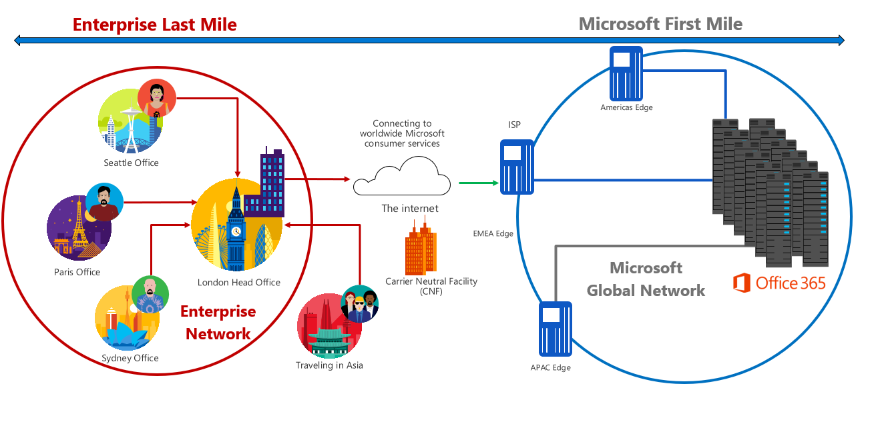
Traditional connectivity
User traffic to SPO routed through main office

Slide 16
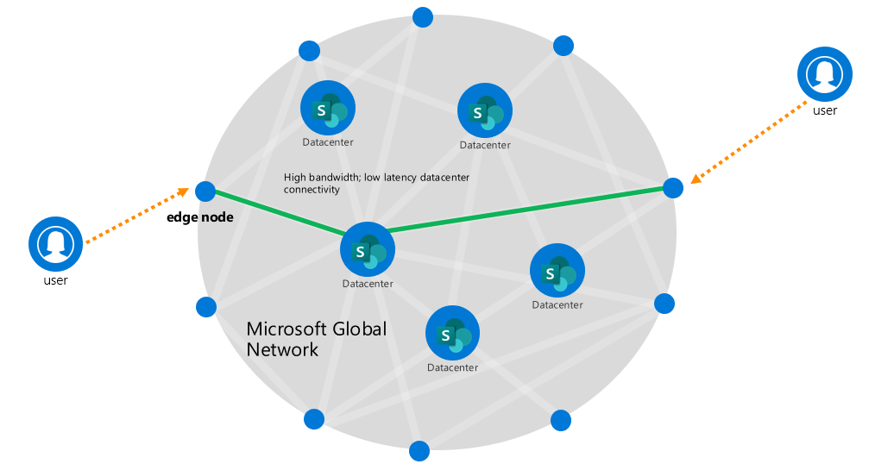
Bringing SharePoint Online to users
Globally distributed edge nodes provide low latency connectivity to the Microsoft Network

Slide 17
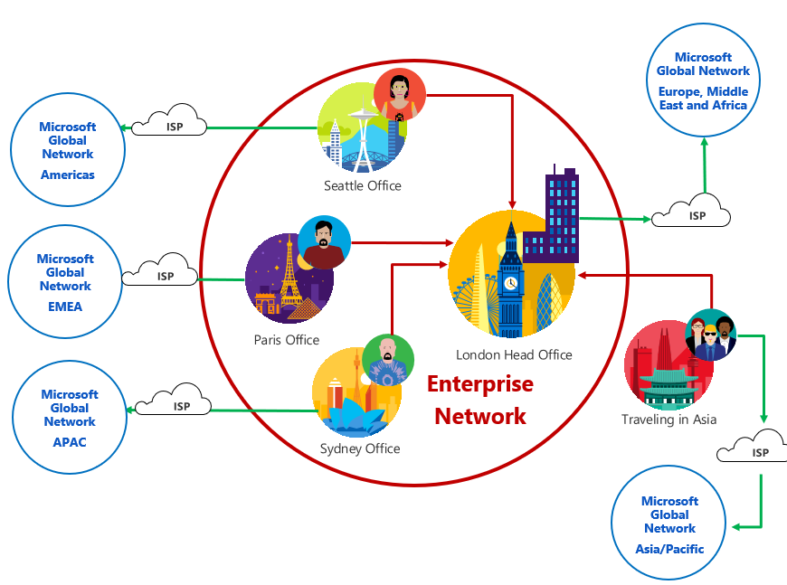
Direct Egress to Microsoft
Globally distributed edge nodes provide low latency connectivity to the Microsoft Network
Network devices identify Microsoft 365 traffic
Local egress to Microsoft Network at every location
Bypass network security stack with trusted SaaS traffic
https://aka.ms/pnc

Slide 18
Microsoft Global Network
Europe, Middle East and Africa
Network devices identify Microsoft 365 traffic
Local egress to Microsoft Network at every location
Bypass network security stack with trusted SaaS traffic
https://aka.ms/pnc
Microsoft Global Network
Americas
ISP
Seattle Office
ISP
Microsoft Global Network
EMEA
ISP
Paris Office
London Head Office
Enterprise
Network
Microsoft Global Network
APAC
ISP
Traveling in Asia
Sydney Office
ISP
Microsoft Global Network
Asia/Pacific

Slide 19
Avoid throttling

Slide 20
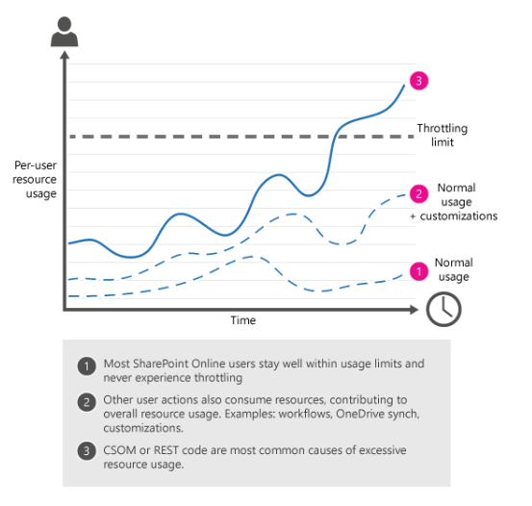
What is throttling?
SharePoint Online uses throttling to maintain optimal performance and reliability of the SharePoint Online service.
Throttling prevents overuse of resources by limiting the number of user actions or concurrent calls (by script or code) allowed.
It is extremely rare for a user to get throttled in SharePoint Online. If you do get throttled, 99% of the time it is because of custom code.

Slide 21
What happens when a user gets throttled
When a user exceeds usage limits, SharePoint Online throttles any further requests from that user account for a short period.
All user actions are throttled while the throttle is in effect.
For requests that a user performs directly in the browser, SharePoint Online redirects you to the throttling information page, and the requests fail.
For all other requests, including CSOM or REST calls, SharePoint Online returns HTTP status code 429 ("Too many requests") or 503 ("Server Too Busy") and the requests will fail.
Notes:
What happens when you get throttled in SharePoint Online?
When a user exceeds usage limits, SharePoint Online throttles any further requests from that user account for a short period. All user actions are throttled while the throttle is in effect.
For requests that a user performs directly in the browser, SharePoint Online redirects you to the throttling information page, and the requests fail.
For all other requests, including CSOM or REST calls, SharePoint Online returns HTTP status code 429 ("Too many requests") or 503 ("Server Too Busy") and the requests will fail.
If the offending process continues to exceed usage limits, SharePoint Online might completely block the process; in this case, you will not see any successful requests and we will notify you of the block in the Microsoft 365 Message Center.

Slide 22
Blocking
Blocking is the most extreme form of throttling
Blocking can occur if long-term, extremely excessive traffic is detected that may threaten the overall health of the SharePoint Online service
Blocks are used to prevent excessive traffic from degrading the performance and reliability of SharePoint Online
A block - which is usually placed at the app, site collection, or user level to prevent the offending process from running until you fix the problem.
If we block your subscription, you must take action to modify the offending processes before the block can be removed.
If we block your subscription, we will notify you of the block in the Microsoft 365 Message Center. The message describes what caused the block, provides guidance on how to resolve the offending issue, and tells you who to contact to get the block removed.
Notes:
Blocking is the most extreme form of throttling. We rarely ever block a tenant, unless we detect long-term, extremely excessive traffic that may threaten the overall health of the SharePoint Online service. We apply blocks to prevent excessive traffic from degrading the performance and reliability of SharePoint Online. A block - which is usually placed at the app or user level - prevents the offending process from running until you fix the problem. If we block your subscription, you must take action to modify the offending processes before the block can be removed.
If we block your subscription we will notify you of the block in the Microsoft 365 Message Center. The message describes what caused the block, provides guidance on how to resolve the offending issue, and tells you who to contact to get the block removed.

Slide 23
How to avoid being throttled
Reduce the frequency of calls
Limit the number of custom JSOM and Rest API calls to SharePoint to be 6 or fewer (per page load)
Decorate your traffic so we know who you are
One of the criteria used for throttling is traffic decoration, which impacts directly on the prioritization of the traffic. Well decorated traffic will be prioritized over traffic which is not properly decorated.
Leverage the retry-after header
Add the ExecuteQueryWithIncrementalRetry extension method in a static class and use it instead of ExecuteQuery to make your code handle throttling requests.
You'll need to use SharePoint Online CSOM version 16.1.8316.1200 (December 2018 version) or higher
Notes:
For more information and additional sample code, see Avoid getting throttled or blocked in SharePoint Online
https://docs.microsoft.com/en-us/sharepoint/dev/general-development/how-to-avoid-getting-throttled-or-blocked-in-sharepoint-online#what-is-throttling
What is definition of undecorated traffic?
Traffic is undecorated if there is no AppID/AppTitle and User Agent string in CSOM or REST API call to SharePoint Online. The User Agent string should be in a specific format as described below.
What are the recommendations?
If you have created an application, the recommendation is to register and use AppID and AppTitle
This will ensure the best overall experience and best path for any future issue resolution.
Also include the User Agent string information as defined in following step.
Make sure to include User Agent string in your API call to SharePoint with following naming convention
Type
User Agent
Description

Slide 24
Why can’t you tell me the exact throttling limits
We continually monitor resource usage on SharePoint Online and depending on usage, we fine-tune thresholds so users can consume the maximum number of resources without degrading the reliability and performance of SharePoint Online
That's why it's so important for your CSOM or REST code to honor the retry-after header value; this lets your code run as fast as possible on any given day, and it lets your code back off "just enough" if it hits throttling limits.
Notes:
Setting and publishing exact throttling limits sounds very straightforward, but in fact it would result in more restrictive limits. We continually monitor resource usage on SharePoint Online. Depending on usage, we fine-tune thresholds so users can consume the maximum number of resources without degrading the reliability and performance of SharePoint Online. That's why it's so important for your CSOM or REST code to honor the retry-after header value; this lets your code run as fast as possible on any given day, and it lets your code back off "just enough" if it hits throttling limits. The code samples later in this article show you how to use the retry-after header.

Slide 25
Knowledge Check
What is the recommended limit of the number of custom JSOM and Rest API calls to SharePoint?
Which type of site navigation is not recommended for publishing portals, especially with portals with deeply nested site structure?
What are some recommended ways to avoid being throttled when using custom code to make JSOM and Rest API calls to SharePoint?
Classic pages 6 or fewer (per page load)
Structured navigation
Reduce the number of operations per request
Reduce the frequency of calls
Decorate your traffic so we know who you are
Leverage the retry-after header
Modern pages 25 or fewer (per page load)
Notes:
What is the recommended limit of the number of custom JSOM and Rest API calls to SharePoint?
Answer: 6 or fewer per page load
Which type of site navigation is not recommended for publishing portals, especially with portals with deeply nested site structure?
Answer: Structural navigation .
What are some recommendation ways to avoid being throttled when using custom code to make JSOM and Rest API calls to SharePoint?
Answer:
Reduce the number of operations per request
Reduce the frequency of calls
Decorate your traffic so we know who you are
Leverage the retry-after header

Slide 26
Summary
In this lesson, you learned how to:
Understand common causes of SharePoint Online page load performance issues
Understand best practice guidence and recommendations for achieving optimal SharePoint Online page performance
Understand how to avoid being throttled

